Slide 1
BASECOP 20th September 2024
British Airways Colour Palette
Use the eyedrop tool to sample the correct colours from the British Airways colour palette on the right of every slide.
The eyedrop tool can be found when you click ‘More Colours’ when looking at your usual colour options.

Slide 2

introductions
Image Placeholders
Image placeholders hold any picture file or icon.
There are three different ways to import a picture into an image placeholder. Do ensure that any imagery brought into the presentation has not been rotated or the orientation changed prior as this may impact its positioning within the placeholder.
Click on the icon in the centre of the placeholder and navigate to your picture file manually.
Drag any image file directly over the placeholder.
Copy an image from another document/presentation. Select the placeholder (by clicking on the frame) and paste the image directly in.
If an image already exists in the layout, simply select the image and press delete. This will revert it back to a placeholder, ready for a new image to be placed. If the image is positioned behind text, make sure to ‘Arrange > send to back’ to reveal the text after adding the image.

Slide 3

Shift-left testing
Dave Seddon

Slide 4
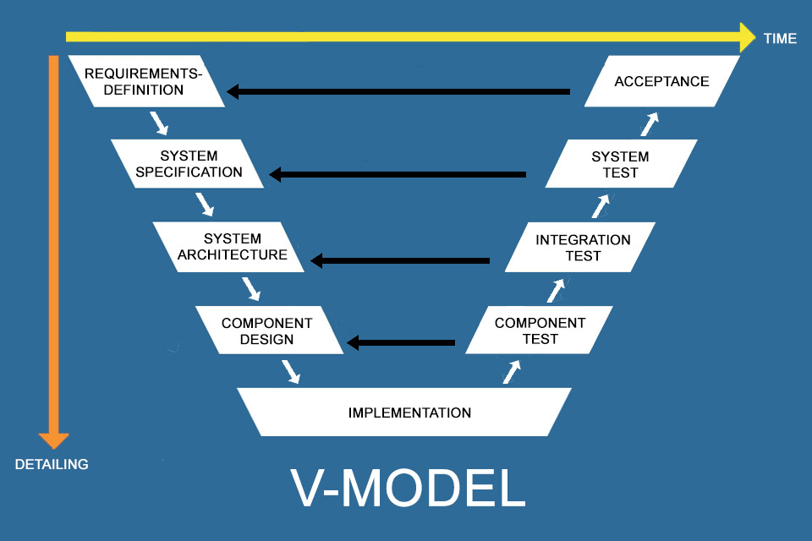
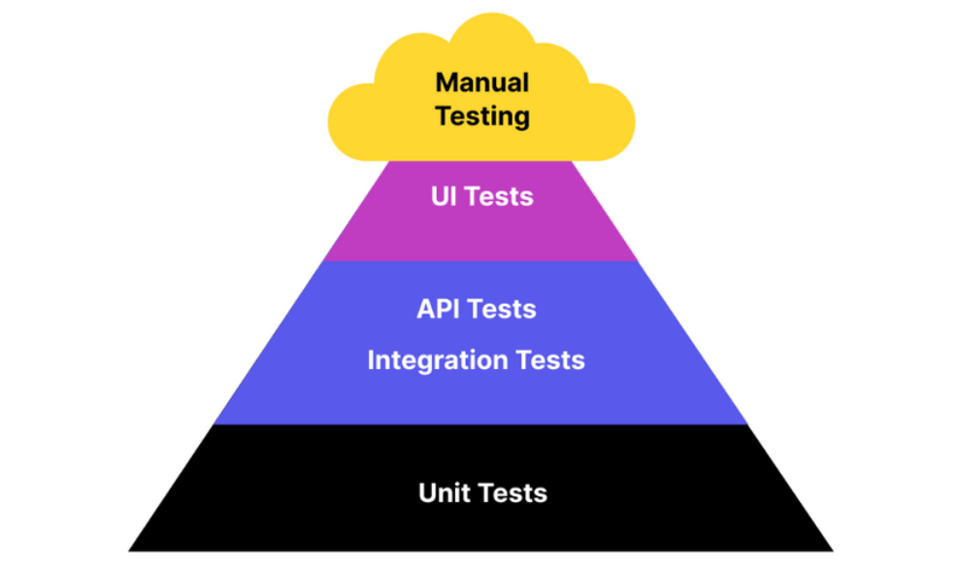
What is shift-left testing?
In the Waterfall method, Testing enters the picture at the very end or to the extreme right of the pipeline.
Shift-left literally pushes testing to the “left,”
Test early and Test often
Shift-left testing focuses heavily on automation
Testing / Quality Assurance is a whole-team responsibility
Notes:
Traditional test approaches will follow the Waterfall delivery method (or V-model test approach). In the Waterfall method, Testing enters the picture at the very end or to the extreme right of the pipeline and tends to be made up mainly of manual test.
Testing literally pushes testing to the “left,” – i.e. to earlier stages in the pipeline. The Shift Left approach, which fits with the Agile Test pyramid, intends to identify and resolve bugs as early as possible in the development process.
Shift-left testing focuses heavily on automation is an “automation-led” approach. This means that we should target 100% of tests to be automated however, in reality, people use the 80/20 rule (80% of tests automated, 20% manual).
In practical terms, this translates to more tests being run by developers (or SDETs) themselves, before they push their individual code units to version control.

Slide 5
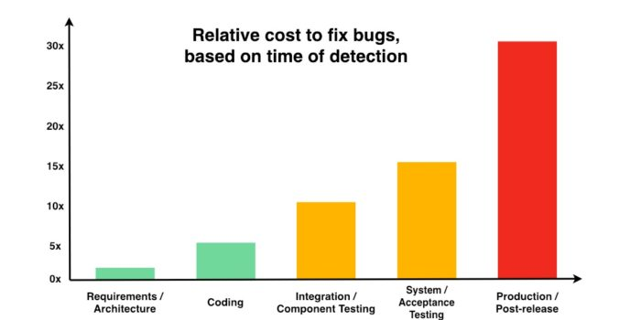
Why shift-left testing?
When testing is left until the end of development, any bugs that do show up will usually be more difficult to fix. Consequences of such an approach would be:
Increase in cost, since the software needs to be sent back and reworked from scratch
Increased time to market since such reworks will take longer to complete
When it comes to fixing bugs, the earlier, the cheaper. See below graph.
According to the NIST, resolving defects in production can cost 30 times more and up to 60 times more in case of security defects.
Notes:
When testing is left until the end of development, any bugs that do show up will usually be more difficult to fix.
Their resolution needs the software to be reworked in its entirety since all the code has already been created. Exhaustive regression testing will also be necessary due to potential wholesale changes within the codebase.

Slide 6
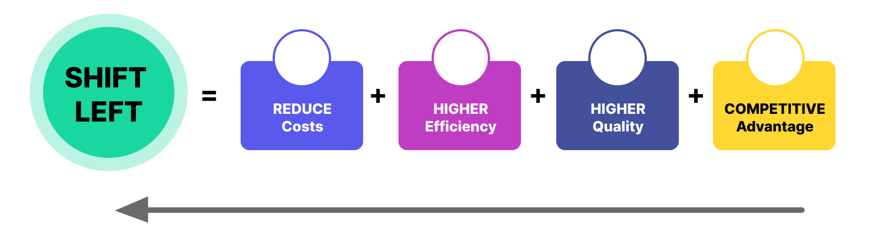
Main benefits of shift-left testing?
There are many benefits to a shift-left testing approach, the main ones are as follows:
Lower costs.
Improved product quality.
Reduced time to market.
Offers a competitive advantage
Whole team responsibility of quality.
Notes:
Lower costs. Increased efficiency in the software development process – reducing overall cycle.
Improved product quality because more bugs are detected in earlier stages.
Reduced time to market since the QA process doesn’t take as much time – focusing heavily on automation tests and repeatability.
Offers a competitive advantage by letting development teams move fast and build and defend their credibility by innovating in iterations.
testing whole team responsibility. Ownership. Removing barriers between dev and test.

Slide 7
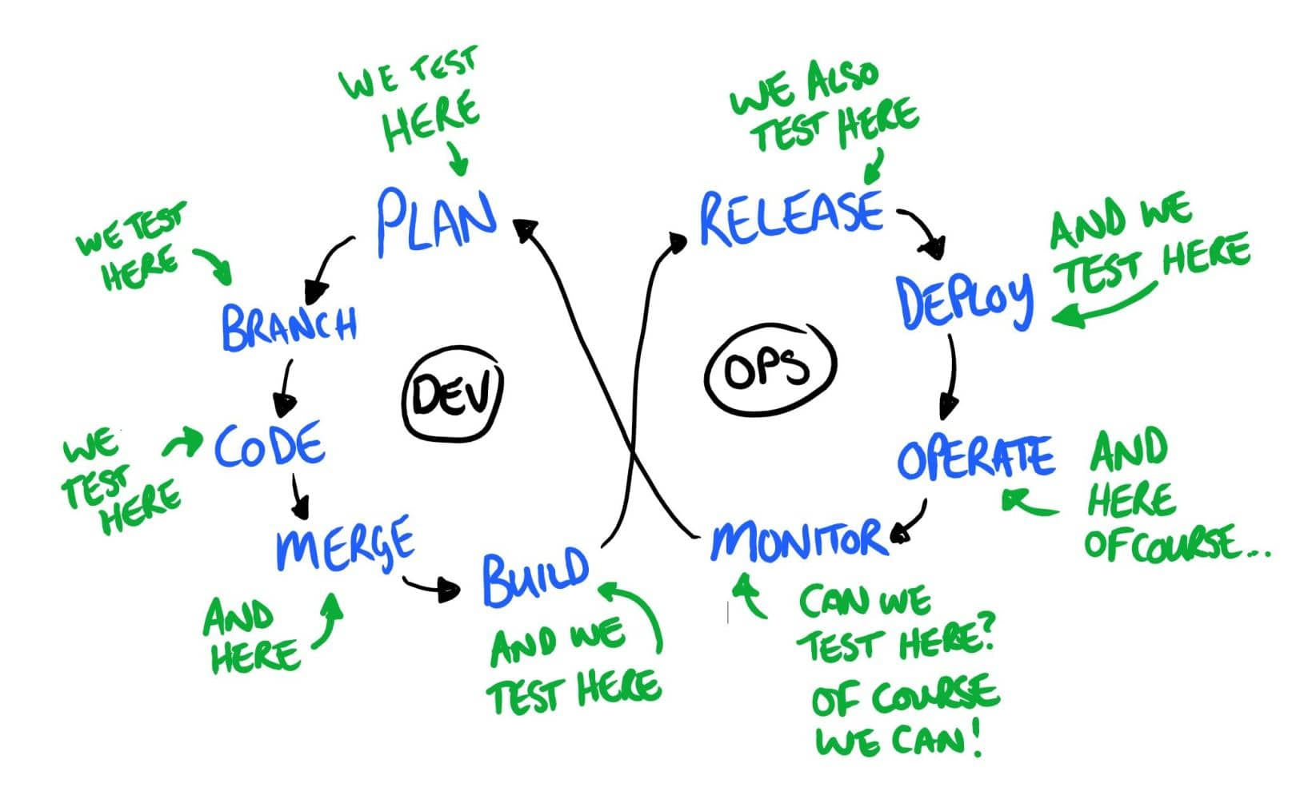
How to implement shift-left testing?
Implementing shift-left as a test approach can be a challenge – the severity of the challenge will differ from company-to-company and even project-project. This is led by things like:
Project priorities
Current ways of working
Resistance to change
Skillset
However, there are some key principles that are mandatory in order to shift-left:
Bring developers into test activities
Hire testers with coding experience and/or introduce existing testers to coding
Include test early on and keep testing often
Keep testability in mind when coding
Use static code analysis
Offer a continuous feedback loop or mechanism
Specific quality standards/guardrails
Notes:
Bring developers into testing activities
When developers test their code before pushing it to the main branch, the merged code is cleaner and less error-prone. Individual code units are easier to test because they are smaller and more navigable.
Introduce testers to coding
Agile in its best avatar (which is usually synonymous with DevOps) requires developers to test and testers to code. Obviously, neither is expected to be an expert at something that is not their primary domain. But devs should be able to run intermediate-level tests, and QAs should know enough coding to implement some quick fixes wherever possible.
Basic coding skills help testers be effective at code reviews and enable them to be valuable contributors in sprint teams. Testers need to be proficient enough to be able to read and modify simple code – such as an automated test or rework fundamental methods.
Include testers early on
Shift Left Test in Agile works best when QAs come in from the first brainstorming session. When developers throw around ideas on how to build a website or app, QAs must be present. This helps them understand the fundamental concepts, allowing them to design better tests for the Continuous Testing stage. Additionally, having QAs in the room can give devs a clear image of what bugs would be likely to emerge and how they can be avoided.
Successful DevOps hinges on automation. QAs need to know how the code is being shaped and what is expected of the final product to create relevant test cases. They cannot be expected to comb through every line of code, looking for every semicolon out of place. Additionally, when devs run tests on their code, they might need input from QAs who can guide them on what to check for.
Keep testability in mind while coding
Like everything in Agile processes and DevOps, collaboration is the key to success. Successful Shift Left Testing also requires a team effort. It can’t be something done only at the end of a sprint by particular individuals (designated testers). When writing code, developers should ask themselves, “How do I make it more testable?”
This might mean exposing a hook or creating a unique ID for an element. Additionally, this way of thinking makes developers aware of issues that can break functionality or cause operational issues. When software is created with its suitability for testing in mind, Shift Left Testing becomes far more effortless.
Use Static Code Analysis
Static code analysis is the practice of checking the code without executing it. It runs through the basic code structure and ensures that the code is aligned with a number of standards and guidelines. Generally, the static analysis looks for the following issues:
Programming errors
Violations of commonly followed coding standards
Syntax anomalies
Security issues
Static code analysis is best done via automation; otherwise, it is impossibly tedious. The software should scan all untested code in a project before it moves to QA. A static code analyzer checks code against a set of predefined standards and rules to determine if the code complies with them.
If the analyzer does flag any issues, a human developer/tester will have to examine them to verify that they are not false positives. Then, devs can fix apparent mistakes and send the code to testers.
Offer continuous feedback
As far as possible, devs and testers should be offered feedback across the software lifecycle. This lets gaps be addressed immediately and offer everyone involved a better perspective on any major trends popping up during testing. It can also help them with future projects, especially ones that would be similar to the current ones.
Specify Quality Standards
Remember that devs are not usually trained in testing from scratch. Therefore, they cannot be expected to intuitively figure out the finer points of testing. QAs and QA managers should outline the level of quality, performance, and operational success expected from the code so that devs running tests know what bugs to look for. They need to have a clear idea of what may be non-negotiable and what issues can be forwarded to QAs (preferably with a few lines of context). Clarity on software quality standards also helps tests apply the right kind of rigour to ferret out bugs in their own code.

Slide 8

TDD in NDC
Rod Taylor

Slide 9
Agenda
Creating Your Own Custom Layouts
If you need to create your own custom layouts to suit a specific slide please align your images / graphs / text to the margins which can be made visible by ‘View > Guides’. Try to avoid placing any content outside the predefined margins.
TDD – The Basics
Why TDD?
Why NOT TDD?
TDD in NDC
Challenges
(Possible) Solution
TDD with Legacy Code
Notes:
The basics – these are reminders only as TDD is not a new concept for most developers.

Slide 10

Test-driven development The basics
Creating Your Own Custom Layouts
If you need to create your own custom layouts to suit a specific slide please align your images / graphs / text to the margins which can be made visible by ‘View > Guides’. Try to avoid placing any content outside the predefined margins.
Kent Beck (TDD by Example): “Test-driven development is a set of techniques that any software engineer can follow, which encourages simple designs and test suites that inspire confidence”
TDD is not about testing, but about:
(Re-)designing your code to make and keep it easily testable
Creating a safety net to making changes with confidence

Slide 11


Test-driven development The basics
Creating Your Own Custom Layouts
If you need to create your own custom layouts to suit a specific slide please align your images / graphs / text to the margins which can be made visible by ‘View > Guides’. Try to avoid placing any content outside the predefined margins.
Uncle Bob in Clean Coder:
You are not allowed to write any production code until you have written a unit test that fails due to its absence.
You are not allowed to write more of a unit test than is sufficient to fail. Failing to compile is failing.
You are not allowed to write more production code than is sufficient to cause the currently failing test to pass.
Step by step reference:
Test-Driven Development by Example – Kent Beck
Test-Driven Development with Java – Alan Mellor
Notes:
Chapter 5 The Clean Coder: A Code of Conduct for Professional Programmers – Robert C. Martin

Slide 12
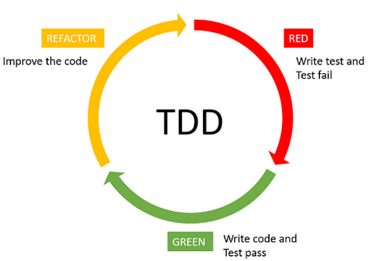
Test-driven development The basics
Creating Your Own Custom Layouts
If you need to create your own custom layouts to suit a specific slide please align your images / graphs / text to the margins which can be made visible by ‘View > Guides’. Try to avoid placing any content outside the predefined margins.
TDD cycle:
Red- Green- Refactor:
Red: start small or not at all
Green: minimal code to pass test
Refactor: design decision
Canary test
1 user story at a time
Dynamic checklist
Notes:
Canary test: dependency test
Dynamic checklist ➔ flexible to do list that we can add as we go along or eliminate if we think is not relevant anymore

Slide 13
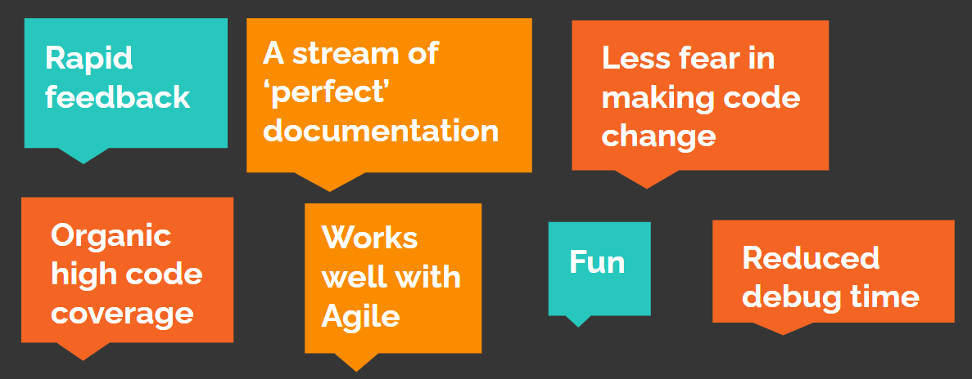
Why tdd?
Creating Your Own Custom Layouts
If you need to create your own custom layouts to suit a specific slide please align your images / graphs / text to the margins which can be made visible by ‘View > Guides’. Try to avoid placing any content outside the predefined margins.
Notes:
What are the benefits of TDD? Why do developers do TDD?
(Menti: My First Poll - Mentimeter)
Discussion on the poll result

Slide 14
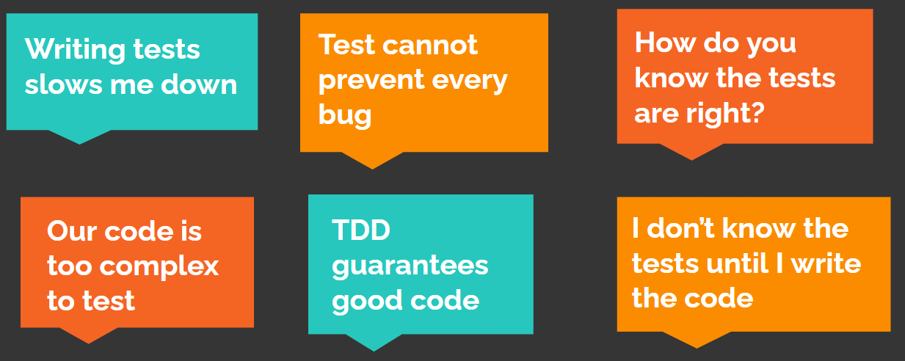
Why NOT tdd?
Creating Your Own Custom Layouts
If you need to create your own custom layouts to suit a specific slide please align your images / graphs / text to the margins which can be made visible by ‘View > Guides’. Try to avoid placing any content outside the predefined margins.
Notes:
What are the disadvantages of TDD? Why don’t developers do TDD?
(Menti: My First Poll - Mentimeter)
Discussion on the poll result
Does any of the audience member can relate to this?
Discussion on the myths.

Slide 15
TDD in NDC
Creating Your Own Custom Layouts
If you need to create your own custom layouts to suit a specific slide please align your images / graphs / text to the margins which can be made visible by ‘View > Guides’. Try to avoid placing any content outside the predefined margins.
Challenges
CAP: Legacy code with built no particular methodology.
Unit tests came years after release
A level of stubbing was glued on afterwards
CAPTWO: support for testing built into platform
originally BDD (using Cucumber)
got abandoned in 2015 as it was deemed to have created extra work
SoapUI test packs are used to cover functionalities on a higher level
NDC 21.3: microservice-based platform
‘mentally scarred’
Lack of enterprise guidance for implementation
Notes:
NDC 21.3:
We are possibly ‘mentally scarred’ by previous experience with CAP and CAPTWO
Lack of enterprise guidance: where do we start, how do we do it, etc, etc

Slide 16
TDD in NDC
Creating Your Own Custom Layouts
If you need to create your own custom layouts to suit a specific slide please align your images / graphs / text to the margins which can be made visible by ‘View > Guides’. Try to avoid placing any content outside the predefined margins.
(Possible) Solution:
CAP and CAPTWO:
(Critical) incremental step to make it better (boy-scout principle)
Hybrid of TDD and practicality
NDC 21.3:
Enterprise-level expert guidance is needed to implement TDD and benefit from it
Shift of existing mindset
New joiners with like mindset and (previous) TDD experience
Notes:
CAP & CAPTWO:
As we’re leaving legacy code behind, we need to be prudent in our time and effort investments towards the platform. Perhaps boy-scout principle of ‘leaving the code in a better state after every commit’ is suitable in this scenario.
Also a level of hybrid TDD and practicality adaptation might be needed here which we’re going to discuss in the next slide.
21.3:
As for NDC 21.3, it feels like we need an enterprise level expert guidance to lead us out from that mental scar of previous experience in CAP and CAPTWO so we can fully grasp the concept of TDD to our advantage
Also, TDD mindset is key on both current developers and new joiners, possibly with their positive experience in TDD, to be able to start and maintain the newly adopted methodology
As we’re still using legacy code in our daily grind, without dedicating a big amount of effort towards TDD, how do we go about it then? In a way that we can still benefit from TDD in legacy code? (next slide)

Slide 17
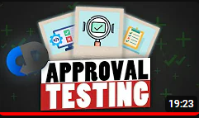
TDD in nDC
Creating Your Own Custom Layouts
If you need to create your own custom layouts to suit a specific slide please align your images / graphs / text to the margins which can be made visible by ‘View > Guides’. Try to avoid placing any content outside the predefined margins.
TDD with legacy code - Steps:
Approval/charaterisation testing: mostly useful when no test code. Test is for output comparison that our change has not broken the existing functionality by having reference output that has been recorded prior to code change. Code coverage ≈ ‘behaviour coverage’. NOTE: library org.approvaltests.Approvals as dependency
Existing tests as documentation – understand system’s behaviour.
Apply TDD for your feature
Good practice: boy-scout-rule as safely as possible (refactor): decluttering, reducing cyclomatic complexity and composing methods.
Sample: Add APPROVAL TESTING To Your Bag Of Tricks (youtube.com)
Notes:
I would call these steps as meeting half-way with TDD, because knowing the benefits without ignoring the challenges requires us to be slightly creative and adaptive to the matter at hand.
1) Approval testing: a step to understand the behaviour of existing code when no test code is available. This is very useful when you need to either refactor the legacy code or apply a new feature without changing the existing behaviour. Approval testing provides that extra safety net in your development process.
2) Now, if the legacy code does have unit tests, you can use the existing test code as approval testing. Code coverage is helpful in finding out that the expected behaviours of the code are known and tested. If you deal with low code coverage code, you might want to increase this first before putting your feature change. This step also helps your understanding of the expected code behaviour you are trying to work with.
IMPORTANT: We are not to fix a bug we encounter during an approval test, because the means you're changing the behaviour of the system. The what seemingly seen as a bug might be not a bug at all as it might be needed downstream by another system.
REMEMBER: refactoring = behaviour preserving.
3) Apply TDD for your feature. Now that you have that safety net, you can start implementing your code change with ease in mind that you’re doing it safely.
As I mentioned earlier that we can make tiny improvements every time we work on legacy code by ‘leaving the code in a better state after every commit’.
This can imply:
1) Decluttering: removing dead code, make use of vcs (version control system) - commit often, revert if necessary
2) Reducing cyclomatic complexity (= number of flows in code ==> branch) by method extraction. Rule of thumb in readability: < 15 lines of code
3) Composing methods

Slide 18
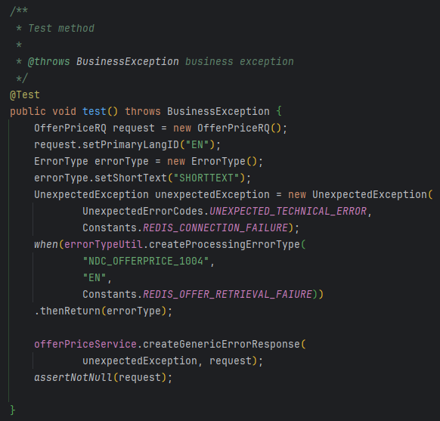
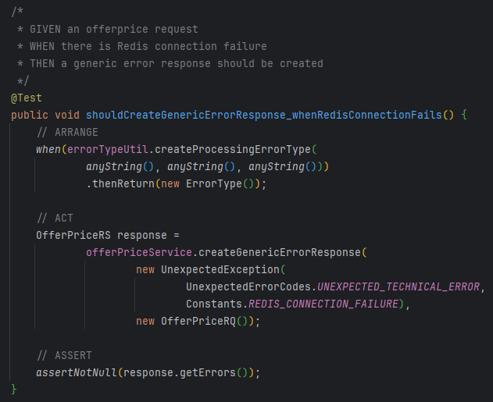
Tdd in ndc
Creating Your Own Custom Layouts
If you need to create your own custom layouts to suit a specific slide please align your images / graphs / text to the margins which can be made visible by ‘View > Guides’. Try to avoid placing any content outside the predefined margins.
Sample:
Notes:
I have here a very simple sample in implementing TDD to improve the readability of a piece of legacy code.
Discussion on the initial method.
Elicit:
Test name
Unclear functionality that the test is performing
Documentation
Comments
Minimal code to test functionality
Incorrect assertion to meet the objective
Fixed method:
Use of ‘Given-When-Then’ as method description
The functionality tested is better defined
Minimal code to achieve the objective
Comments – AAA comment is added for readability clarity
Suitable assertion to meet the objective

Slide 19

Coming soon at basecop…

Slide 20
Creating Your Own Custom Layouts
If you need to create your own custom layouts to suit a specific slide please align your images / graphs / text to the margins which can be made visible by ‘View > Guides’. Try to avoid placing any content outside the predefined margins.
Future presentations will include, but not limited to:
Why is Unit testing important to shift-left? Utilising tools like SonarCloud & CodeScene
How do we approach Contract testing? Pact? PactFlow with SwaggerHub? AWS CloudFormation CLI?
Integration vs UI test coverage and how it applies to shift-left
What about Non-Functional Testing when shifting-left?
Importance of automation and the usage of CI/CD pipelines
An overview of the new IAG Test Strategy and how to apply it at project level

Slide 21

THANK YOU

